Slide 1
Welcome to
CSE 4109:
Artificial Intelligence
Credits: 3 for Theory and 0.75 for Laboratory Works

Slide 2
Course Kit:
Text Book: Artificial Intelligence: A Modern Approach, Stuart Russel and Peter Norvig, Prentice-Hall International Inc.
Reference Book:
Nils J. Nilsson, Artificial Intelligence: A New Synthesis, Morgan Kaufmann 1998.

Slide 3
Course Contents
Introduction: Definition, AI technique, Application.
Intelligent Agent: Introduction, Structure of intelligent agent, Agent programs, Goal-based agents, Environments.
Problem Solving: Solving problem by searching, Problem solving by agent, Formulating problems, Toy problems, Search strategies, Breadth-First, Uniform cost, Depth-First, Depth-limited and iterative deepening search, Informed search methods, Best-First, Greedy and A* search, Heuristic functions, IDA* search, Iterative improvement algorithms, Hill-Climbing search, Simulated annealing, Introduction to game playing, Perfect decisions in two person games, Imperfect decisions, Alpha-Beta pruning, State-of-the-Art games programs: Chess, Checkers, Backgammon.
Knowledge and Reasoning: Knowledge-Based agent, Representation, Reasoning and logic, Propositional logic.
First-Order Logic: Syntax and semantics, Terms, Atomic and complex sentences, Quantifiers, Equality, Extensions and notational variations, Higher-order logic, Using first-order logic, Axioms, Definitions and theorems.
Inference in First-Order Logic: Inference rules involving quantifiers, Generalized modus ponens, Canonical form, Unification, Forward and backward chaining, Completeness, Resolution inference rule, Canonical forms for resolution, Resolution proofs, Conversion to normal form.
Uncertain Knowledge and Reasoning: Uncertainty, Acting under uncertainty, Basic probability notation, Conditional probability, Axioms of probability, Bayes rules and its use, Normalization.
Probabilistic Reasoning Systems: Representing knowledge in an uncertain domain, Knowledge engineering for uncertain reasoning, Default reasoning, Rule-based methods for uncertain reasoning, Dempster-shafer theory, Fuzzy sets and fuzzy logic.
Communicating, Perceiving, Planning and Acting: Natural language understanding: Syntactic processing, Ambiguity resolution, Text understanding.
Action: The situation calculus, A simple solution to the framework problem, Complex actions, Planning: Planning in the situation calculus,The STRIPS representation, Planning as a reasoning task.

Slide 4
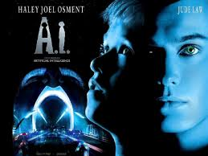
AI – The Movie
• Many people will leave the cinema after seeing Spielberg’s film AI and think all they saw will become reality soon.
• So what is AI and how far has it got?
• The AI film was based on a story by Brian Aldiss ‘Supertoys last all summer long’ written in 1969.
Recently, he wrote: ‘Brains are far more than mere computers… Intelligence cannot exist without consciousness. Artificial consciousness: that sounds like a taller order, and indeed it is. … So what I believed in 1969 is what I do not believe in 2001’ (New Scientist 09/15/01).

Slide 5
AI – The History
• AI is nearly as old as computing
• 1941 Konrad Zuse, Germany, general purpose computer
• 1943 Britain (Turing and others) Colossus, for decoding
• 1945 ENIAC, US. John von Neumann a consultant
• 1956 Dartmouth Conference organized by John McCarthy (inventor of LISP)
• The term Artificial Intelligence was coined at Dartmouth, which was intended as a two month study.

Slide 6
AI – The Achievements
Robots make cars in all advanced countries.
• Reasonable machine translation is available for a large range of foreign web pages.
• Computers land 200 ton jumbo jets unaided every few minutes.
• Search systems like Google are not perfect but provide very effective information retrieval
• Robots cut slots for hip joints better than surgeons.
• Deep blue beat Kasparov in 1997 and the current world Go champion is a computer.
• Medical expert systems can outperform doctors in many areas of diagnosis.

Slide 7
AI – A Comment
Despite all these achievements, one of the major philosophers of Cognitive Science wrote recently:
“… the failure of artificial intelligence to produce successful simulation of routine commonsense cognitive competences is notorious, not to say scandalous. We still don't have the fabled machine that can make breakfast without burning down the house; or the one that can translate everyday English into everyday Italian, or the one that can summarize texts..” (Jerry Fodor, The Mind doesn’t Work that Way, 2000, p.37).

Slide 8
What is Artificial Intelligence?
The use of computer programs and programming techniques to cast light on the principles of intelligence in general and human thought in particular (Boden)
• The study of intelligence independent of its embodiment in humans, animals or machines (McCarthy)
• The pursuit of metaphysics by other means (Longuet-Higgins)
• AI is the study of how to do things which at the moment people do better (Rich & Knight)
• AI is the science of making machines do things that would require intelligence if done by men. (Minsky)

Slide 9
What is Artificial Intelligence?
One of major divisions in AI (and you can see it in the definitions on the previous slide) is between
Those who think AI is the only serious way of finding
out how we work (since opening heads does not yet
give much insight into this) and
• Those who want computers to do very smart
things, independently of how we work.
This is the important distinction between
Cognitive Scientists vs. Engineers.

Slide 10
Definitions of AI
if our system can be more rational than humans in some cases, why not?
Systems that think like humans | Systems that think rationally
Systems that act like humans | Systems that act rationally
focus on action avoids philosophical issues such as “is the system conscious” etc.
We will follow “act rationally” approach
  Distinction may not be that important
    acting rationally/like a human presumably requires (some sort of) thinking rationally/like a human,
    humans much more rational anyway in complex domains

Slide 11
Real AI
A serious science.
General-purpose AI like the robots of science fiction is incredibly hard
  Human brain appears to have lots of special and general functions, integrated in some amazing way that we really do not understand at all (yet)

Slide 12
Real AI
Special-purpose AI is more doable (nontrivial)
  E.g., chess/poker playing programs, logistics planning, automated translation, voice recognition, web search, data mining, medical diagnosis, keeping a car on the road, … … … …

Slide 13
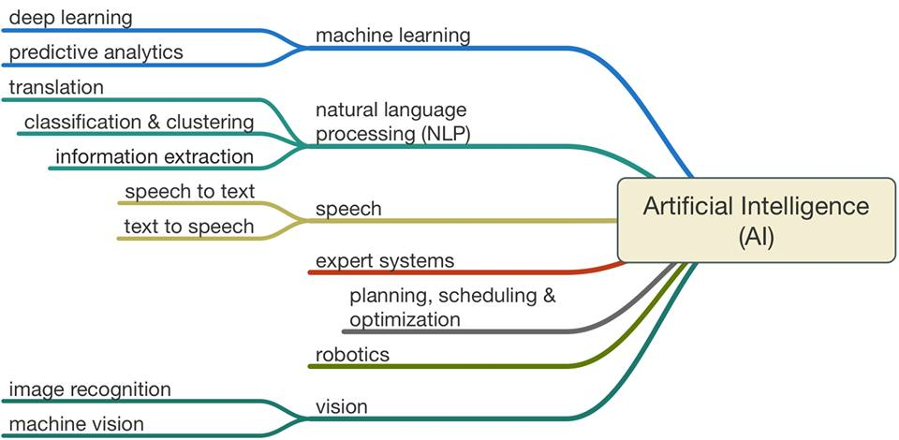
Artificial Intelligence Demystified

Slide 14
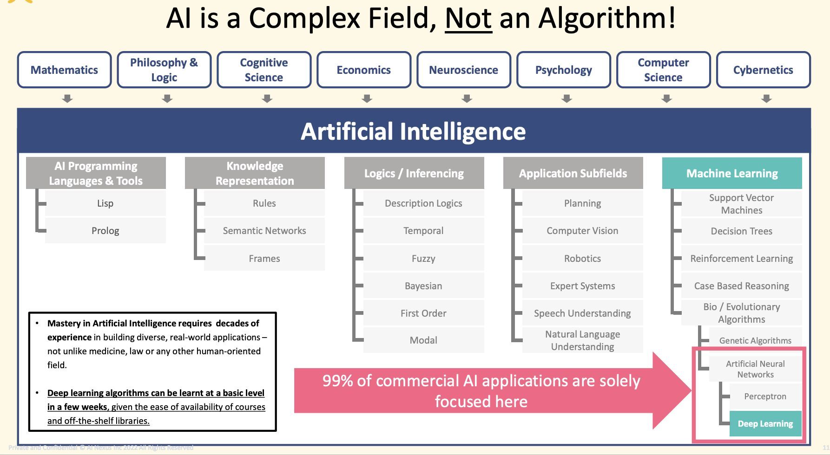
AI is a Complex Field!!

Slide 15
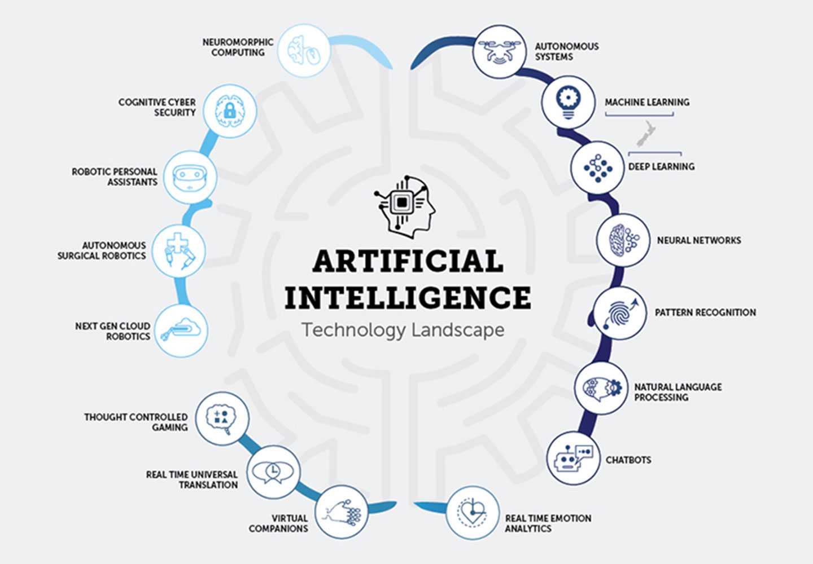

Slide 16
Natural Intelligence
Before we start building “intelligent” systems, let us first consider examples of intelligence that we find in nature.
Of course there we will find many different levels of intelligence, cognitive abilities, and consciousness.
We will start with very basic abilities and make our way towards the highest forms of intelligence that are currently known to us.

Slide 17
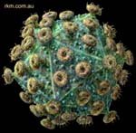

Viruses
not considered to be alive
do not reproduce on their own, but make bacteria produce copies of themselves
no learning in individual viruses; only “evolutionary learning”

Slide 18
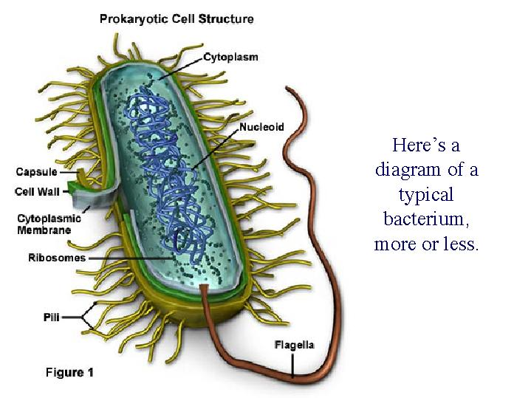
Bacteria
are considered to be alive
reproduce by splitting up into two organisms
capable of some simple learning that allows them to move towards favorable environments

Slide 19
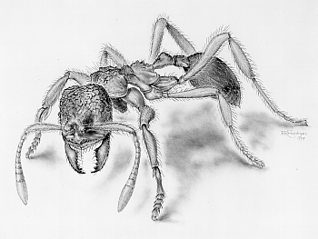
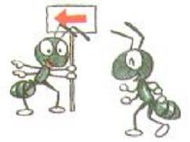
Insects
capable of learning and memorizing
primitive social interactions (trail of pheromones)
simple visual and olfactory perception (compound eyes)
coordinated movements of legs to master different types of terrains

Slide 20

Reptiles
good capability of vision (eyeballs, eye movements)
able to learn certain behaviors
hunting abilities
still very primitive social interactions

Slide 21

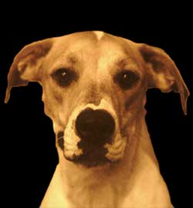
Higher Mammals
very powerful senses
produce sounds but no language
complex social interactions
probably consciousness and basic feelings that are related to our own

Slide 22
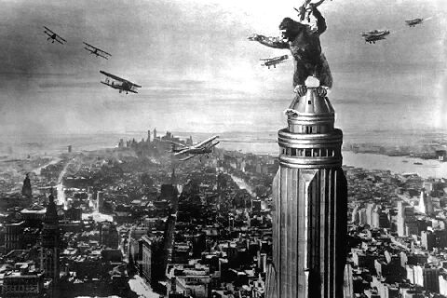
Non-Human Primates
very human-like genetic makeup and behaviors
produce different sounds with different meanings
capable of learning symbolic “language”
probably consciousness, self-awareness and basic feelings at the level of a human kid

Slide 23
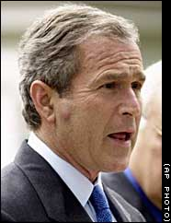
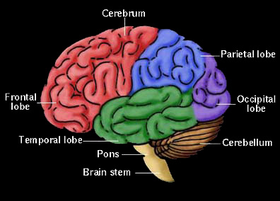
Humans
complex social behaviors
able to learn high-level syntactic languages
extremely long phase of learning (upbringing)
consciousness, self-awareness, abstract thinking
awareness of past and future, planning capability

Slide 24
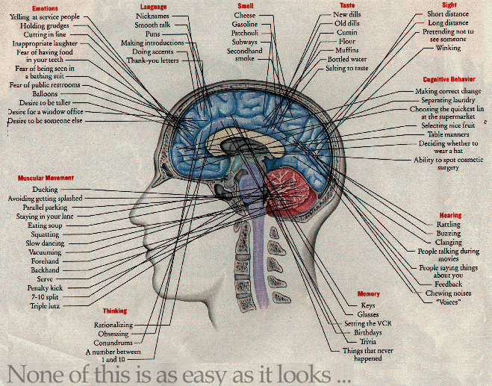

Slide 25
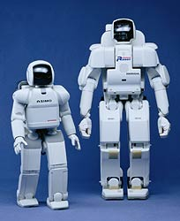
Robots (Current Stage)
built by humans
coordinated body movements
little learning capabilities
no real social interaction or language
no consciousness or self-awareness

Slide 26
Levels of Artificial Intelligence
Today’s computers can do many well-defined tasks (for example, arithmetic operations), much faster and more accurate than human beings.
However, the computers’ interaction with their environment is not very sophisticated yet.
How can we test whether a computer has reached the general intelligence level of a human being?
Turing Test: Can a computer convince a human interrogator that it is a human?
But before thinking of such advanced kinds of machines, we will start developing our own extremely simple “intelligent” machines.

Slide 27
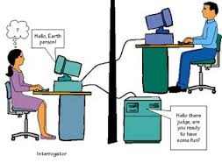
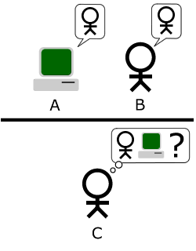
Turing Test
The "standard interpretation" of the Turing Test, in which player C, the interrogator, is given the task of trying to determine which player – A or B – is a computer and which is a human. The interrogator is limited to using the responses to written questions to make the determination.

Slide 28
A Trip to Grid-Space World
Grid-space world is an extremely simple model of our own world.
It is a three-dimensional space with a floor that is divided into cells by a two-dimensional grid.
The cells can be empty or contain objects or agents.
There can be walls between sets of cells.
The agents are confined to the floor and can move from cell to cell.
A robot in grid-space world can sense whether neighboring cells are empty or not.

Slide 29
Perception and Action
Organisms in the real world have to do two basic things in order to survive:
They have to gather information about their
environment (perception) and
based on this information, they have to manipulate
their environment (including themselves) in a way
that is advantageous to them (action).
The action in turn may cause a change in the organism’s perception, which can lead to a different type of action.
We call this the perception-action cycle.

Slide 30
Perception and Action
Complex organisms do not just perceive and act, but they also have an internal state that changes based on the success of previous perception-action cycles.
This is the mechanism of learning.
We will first consider a very simple robot that lives in grid-space world and has no internal state.
The grid has no tight spaces, that is, spaces between objects and boundaries that are only one cell wide.

Slide 31
Perception and Action
The robot is supposed to find a cell next to a boundary or object and then follow that boundary forever.
As we said, the robot can perceive the state of its neighboring cells:
s₁ | s₂ | s₃
s₈ |  | s₄
s₇ | s₆ | s₅

Slide 32
Perception and Action
The robot can move to a free adjacent cell in its column or row. Consequently, there are four possible actions that it can take:
north: moves the robot one cell up
east: moves the robot one cell to the right
south: moves the robot one cell down
west: moves the robot one cell to the left

Slide 33
Immediate Perception-Action
Now that we specified the robot’s capabilities, its environment, and its task, we need to give “life” to the robot.
In other words, we have to specify a function that maps sensory inputs to movement actions so that the robot will carry out its task.
Since we do not want the robot to remember or learn anything, one such function would be sufficient.
However, it is useful to decompose it in the following way (next slide):

Slide 34
Immediate Perception-Action
Feature vector X
0
0
1
1
0
0
…
…
…
1
Sensory
input
Perceptual processing
Action function
Action

Slide 35
Immediate Perception-Action
The functional decomposition has two advantages:
Multiple action functions can be added that receive the same feature vector as their input,
It is possible to add an internal state to the system to implement memory and learning.

Slide 36
The Robot’s Perception
For our robot, we define four different features x₁, …, x₄ that are important to it.
Each feature has value 1 if and only if at least one of the shaded cells is not free:
s₁
s₂
s₃
s₁
s₂
s₃
s₁
s₂
s₃
s₁
s₂
s₃
s₈
s₄
s₈
s₄
s₈
s₄
s₈
s₄
s₇
s₆
s₅
s₇
s₆
s₅
s₇
s₆
s₅
s₇
s₆
s₅
x₁
x₂
x₃
x₄

Slide 37
The Robot’s Action
To execute action, we define an ordered set of rules:
if x₁ = 0 and x₂ = 0 and x₃ = 0 and x₄ = 0 move north
if x₁ = 1 and x₂ = 0 move east
if x₂ = 1 and x₃ = 0 move south
if x₃ = 1 and x₄ = 0 move west
if x₄ = 1 and x₁ = 0 move north
s₁
s₂
s₃
s₁
s₂
s₃
s₁
s₂
s₃
s₁
s₂
s₃
s₈
s₄
s₈
s₄
s₈
s₄
s₈
s₄
s₇
s₆
s₅
s₇
s₆
s₅
s₇
s₆
s₅
s₇
s₆
s₅
x₁
x₂
x₃
x₄

Slide 38
Task Completion
Rules
1
2
1
1
3
1
3
2

4
4
4
4
4
4
4
5
1
3
3
5
1
3
2
2
2
3

3
5
2
5
1
3
3
5
3
5
1
4
4
4
3
3
2
1
3
2
2
2
1
3
4

4
4
5
3
5
3
5

4
4
3

Slide 39
Production Systems
Production systems are a standardized way to represent action functions.
A production system consists of an ordered list of production rules (productions).
Each rule is written in the form condition → action.
A production system is therefore written like:
c₁ → a₁
c₂ → a₂
⋅⋅⋅
c_{m} → a_{m}
The action of the first rule whose condition evaluates to 1 is executed.

Slide 40
Production Systems
Using Boolean notation, the production system for our boundary-following robot looks like this:
x₄x₁ → north
x₃x₄ → west
x₂x₃ → south
x₁x₂ → east
1→ north

